Slide 1
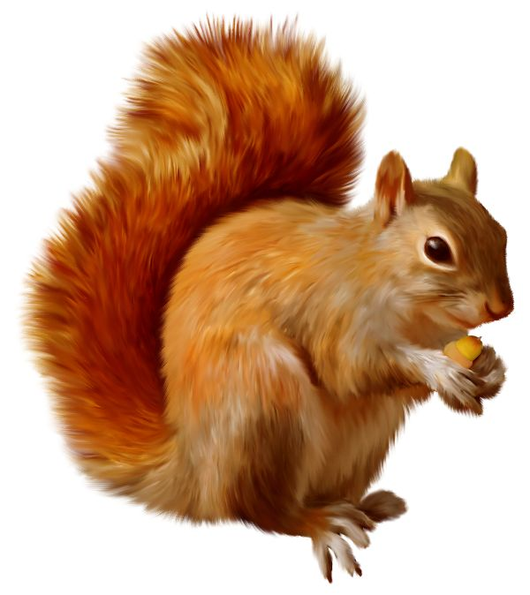
Cheer for the biosphere that’s special to our island
Cheer for the biosphere that makes us so unique
Oh, oh, oh what a wonderful sight,
When I went walking on the Isle of Wight.
1 Red squirrel climbing up a tree…

Slide 2
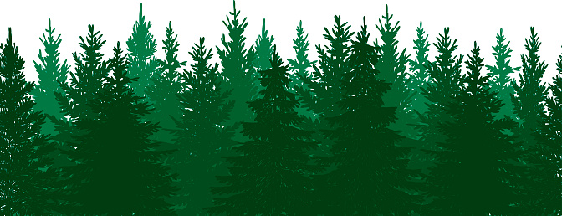
Oh, oh, oh what a wonderful sight,
When I went walking on the Isle of Wight.
2 Green forests and
1 Red squirrel climbing up a tree…

Slide 3
Oh, oh, oh what a wonderful sight,
When I went walking on the Isle of Wight.
3 Chalky Needles
2 Green forests and
1 Red squirrel climbing up a tree…

Slide 4
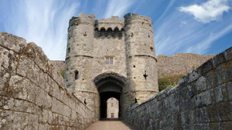
Oh, oh, oh what a wonderful sight,
When I went walking on the Isle of Wight.
4 Ancient buildings
3 Chalky Needles
2 Green forests and
1 Red squirrel climbing up a tree…

Slide 5
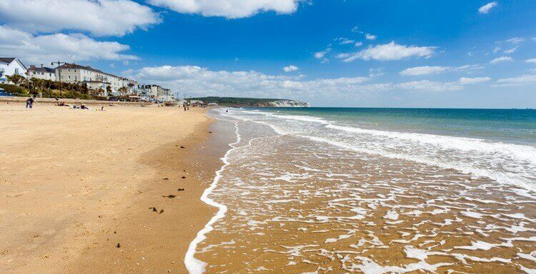
Oh, oh, oh what a wonderful sight,
When I went walking on the Isle of Wight.
5 Sandy Beaches
4 Ancient buildings
3 Chalky Needles
2 Green forests and
1 Red squirrel climbing up a tree…

Slide 6
Cheer for the biosphere that’s special to our island
Cheer for the biosphere that makes us so unique
Oh, oh, oh what a wonderful sight,
When I went walking on the Isle of Wight.
6 Spiny seahorses

Slide 7
5 Sandy Beaches
4 Ancient buildings
3 Chalky Needles
2 Green forests and
1 Red squirrel climbing up a tree…

Slide 8
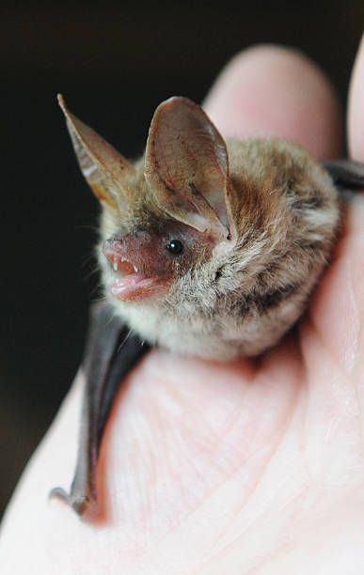
Oh, oh, oh what a wonderful sight,
When I went walking on the Isle of Wight.
7 Rare bats
6 Spiny seahorses

Slide 9
5 Sandy Beaches
4 Ancient buildings
3 Chalky Needles
2 Green forests and
1 Red squirrel climbing up a tree…

Slide 10
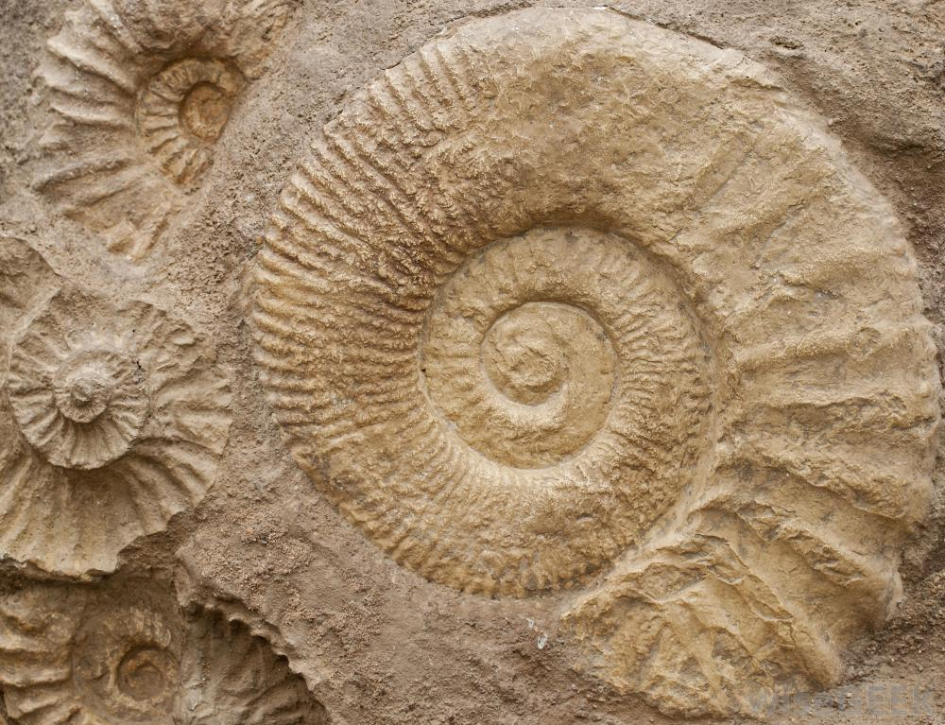
Oh, oh, oh what a wonderful sight,
When I went walking on the Isle of Wight.
8 Old fossils
7 Rare bats
6 Spiny seahorses

Slide 11
5 Sandy Beaches
4 Ancient buildings
3 Chalky Needles
2 Green forests and
1 Red squirrel climbing up a tree…

Slide 12
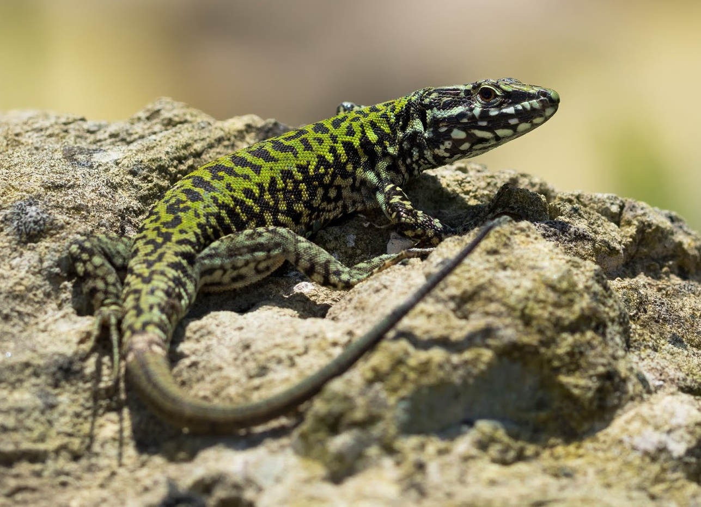
Oh, oh, oh what a wonderful sight,
When I went walking on the Isle of Wight.
9 Wall lizards
8 Old fossils
7 Rare bats
6 Spiny seahorses

Slide 13
5 Sandy Beaches
4 Ancient buildings
3 Chalky Needles
2 Green forests and
1 Red squirrel climbing up a tree…

Slide 14
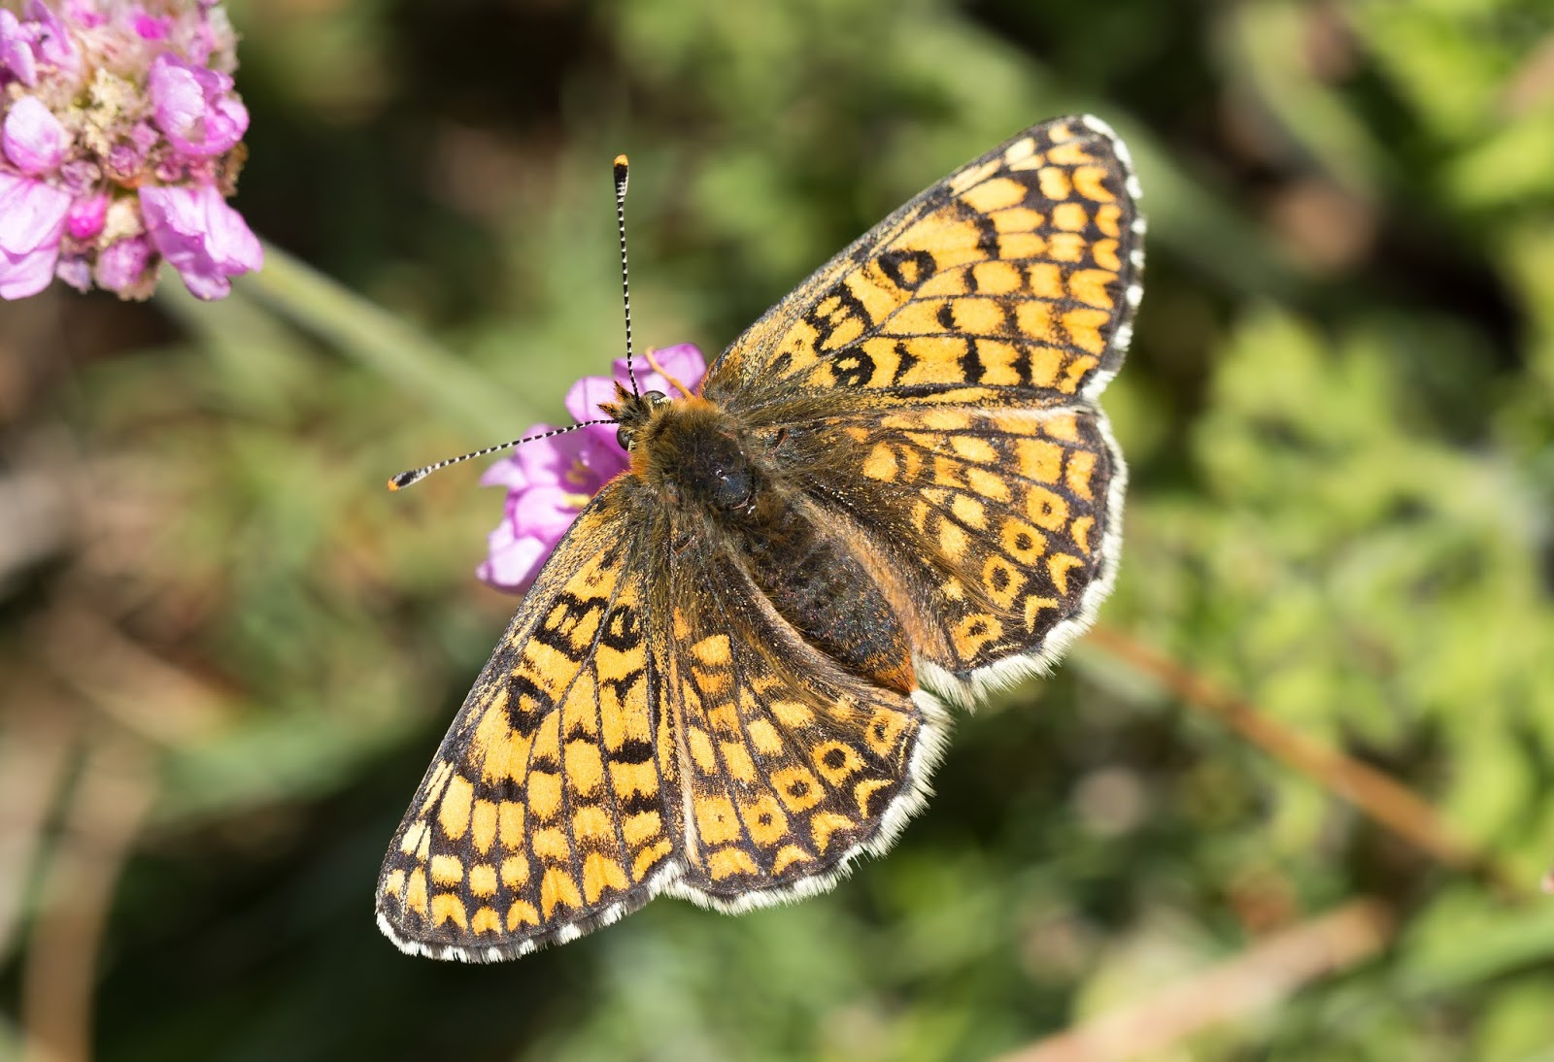
Oh, oh, oh what a wonderful sight,
When I went walking on the Isle of Wight.
10 Glanville butterflies
9 Wall lizards
8 Old fossils
7 Rare bats
6 Spiny seahorses

Slide 15
5 Sandy Beaches
4 Ancient buildings
3 Chalky Needles
2 Green forests and
1 Red squirrel climbing up a tree…

Slide 16
Cheer for the biosphere that’s special to our island
Cheer for the biosphere that makes us so unique
Cheer for the biosphere that’s special to our island
Cheer for the biosphere that makes us so unique

